Slide 1
Aid in the Form of Soft Loans: Export Promotion or Development Policy?
“A Comparative Analysis of Soft Loan Policies in Austria, Denmark, Germany and the Netherlands”
Werner Raza, DIIS Workshop, 2/12/2014, Copenhagen

Slide 2
Structure of the Presentation
Introduction to the Study
Statistical Overview of Soft Loan Financing
Comparative Conclusions from Case Study Analysis
Options for the Future of Soft Loan Financing
page 2

Slide 3
I. Introduction to the Study

Slide 4
Motivation and Research Focus (I)
Motivation of the Study:
  So far little academic and public attention, though widely used instrument of external finance
  Though counted as ODA, the developmental dimension of soft loan policies has remained rather vague; this begs the question, whether there is a potential to be exploited for a stronger development orientation of soft loans
Research Questions:
How are development policy aspects integrated into design of soft loan policies at the international level (mainly the Arrangement)? Are they consistent with OECD’s standards & principles for development policy?
How are development policy aspects implemented in national soft loan programs (case studies) ?
page 4

Slide 5
Motivation and Research Focus (II)
Main Parts of the Study:
  Historical Evolution and Institutional Structure of Tied Aid
  Soft Loan Policies of Four European Donor Countries (Case Studies)
Methods:
  Desk Research
  Data Analysis
  Document Analysis of OECD Archive Footage (1978 – 2005)
  Expert Interviews
  Case Study Analysis
page 5

Slide 6
Key Terminology
Tied Aid Credit:
  Concessional long-term credit (state-supported)
  Minimum concessionality level of 35 or 50% (depending on recipient country)
  Limited pool of recipient countries (GNI threshold)
  Tied to procurement of goods and services in the donor country
  Regulated by the Arrangement on Officially Supported Export Credits (in particular Helsinki Package)
Soft Loan:
  A concessional loan irrespective of tying status (not subject to the Arrangement)
Development Orientation:
  DAC guidelines and principles (e.g. Paris Declaration, Policy Coherence for Development)
page 6

Slide 7
II. Statistical Overview

Slide 8
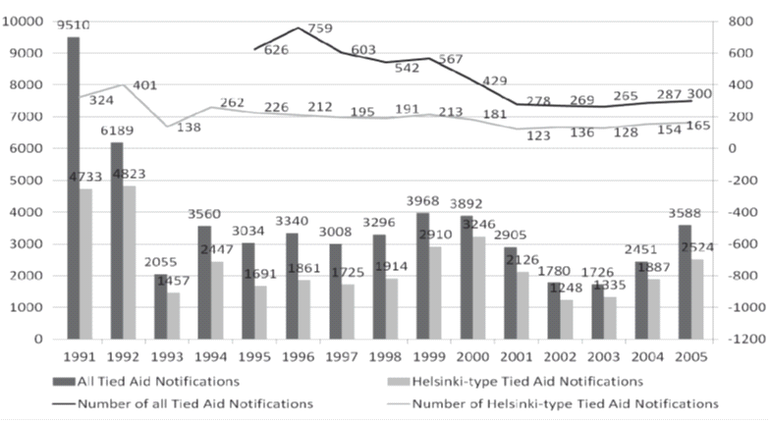
Quantitative Importance of Soft Loans (1)
Overview of the Volume and Number of Tied Aid Notifications
(million USD)
page 8

Slide 9
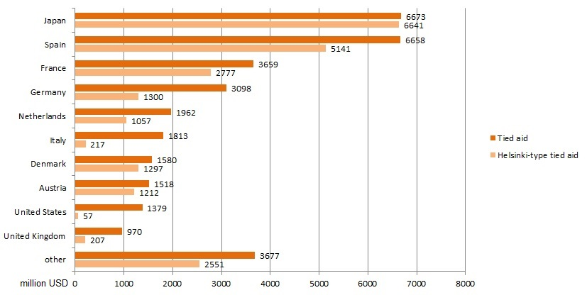
Quantitative Importance of Soft Loans (2)
Donors According to the Volume of Helsinki-Type Tied Aid
and Tied Aid per Donor Country (1995-2005)
page 9

Slide 10
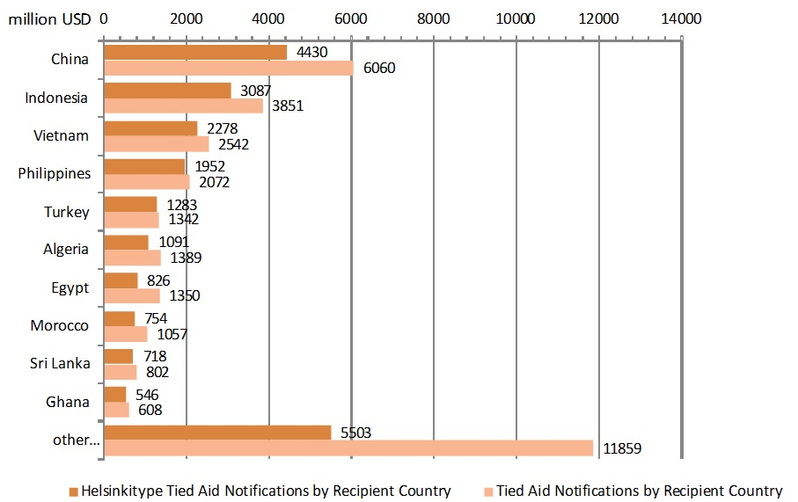
Quantitative Importance of Soft Loans (3)
Absolute Helsinki-Type Tied Aid and Total Tied Aid
by Recipient Country
page 10

Slide 11
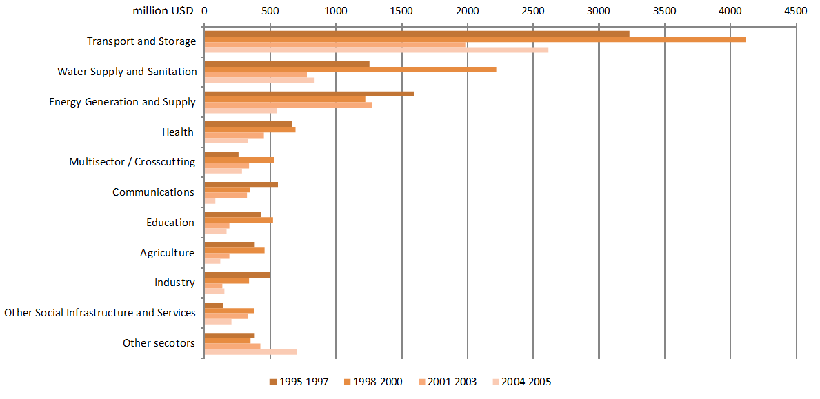
Quantitative Importance of Soft Loans (4)
Total Tied Aid by Sector
page 11

Slide 12
III. Comparative Assessment of Case Studies

Slide 13
Case Studies: Soft Loan Policies of Four European Donor Countries
Main Research Questions:
  To which extent and in which ways are development policy aspects integrated into national soft loan programs in selected OECD countries?
    How are development policy aspects articulated in the institutional set-up, decision-making processes, project evaluation procedures as well as transparency and accountability principles of the national soft loan programs?
    Which commonalities and differences exist between national soft loan programs in particular with regard to program characteristics and objectives, institutional arrangements and development orientation?
Choice of the Case Studies:
  Criterion 1: European financiers with large funding volumes
  Criterion 2: Open economies that pursue export-oriented policies
  Criterion 3: States that are generally considered pioneers in the field of development assistance
  ➔ Austria, Germany, Denmark, the Netherlands
page 13

Slide 14
Austria: Soft Loan Program
Characteristics of the program:
  Tied credits in accordance with Arrangement terms
  Under the responsibility of the Ministry of Finance
  Established, organized and promoted within the scope of the official export promotion activities (BMF, OeKB, WKO)
Development Orientation:
  Not aligned with program and country priorities of Austrian Development Cooperation
  Contribution to sustainable development in recipient country required, core tool to assess developmental impact is a questionnaire, to be completed by exporter
page 14

Slide 15
Germany: Financial Cooperation
Characteristics:
  Soft loans and other concessional finance instruments
  Annual Federal Budget Funds 2012: EUR 1.6 billion
  Leveraging of public funds with private capital
    Development Loans: Total KfW funds to Total Budget Funds: 7:1 in 2007; 13:1 in 2012
Development Orientation:
  Alignment (+); Ownership (±);
  Officially untied; 60-70% % of deliverables are de-facto tied
  Informational and institutional advantages
page 15

Slide 16
The Netherlands: Dutch Programs
Characteristics:
  Officially no soft loan programs, de facto combination of grants and loans (export credits); results are mixed credits
  ORET-program -> ORIO (2009) officially untied; de facto tied
  Annual ORIO Budget 2012: EUR 180 million
  DGGF (2014): concessional finance, tied pillar
Development Orientation:
  Economic view of development
  Strong influence of Dutch business
  Dutch policy oriented towards export finance
page 16

Slide 17
Denmark: Danida Business Finance (DBF)
Characteristics of DBF:
  Tied mixed credits in accordance with Arrangement terms
  Since 2002 untied window – only if NCB not successful
  Annual Budget: ~ EUR 40 Million
Development Orientation:
  Integrated into the Ministry of Foreign Affairs/Danida
  Aligned with priority countries of Danish development cooperation
  (to be) aligned with Danida’s green growth agenda
  Project approval by Danida‘s Grant Committees on the basis of project appraisals (including field missions)
page 17

Slide 18
Comparative Assessment
High Institutional Heterogeneity of Soft Loan Financing
Hybrid Instruments In-Between Export Promotion and Development Policy
Investments in Infrastructure as Key to Development
page 18

Slide 19
IV. Options for the Future of Soft Loan Financing

Slide 20
Emerging Trends in Development Finance
Graduation of traditional recipients (e.g. China) ➔ loss of markets
Partial shift to untying ➔ but not necessarily development motivated
Low-interest rate environment ➔ difficult to reach minimum concessionality level without budget contributions
Fiscal austerity in EU ➔ scarcity of ODA resources
Shift to export-led growth strategies ➔ export interests again more important
New Donors ➔ competition for export markets vs. more funds available for development
page 20

Slide 21
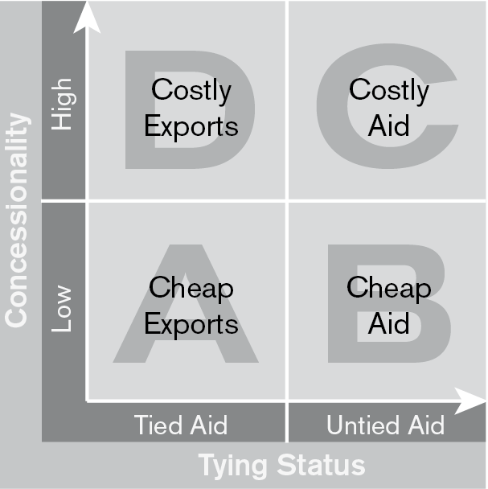
Four Scenarios for the Future
page 21

Slide 22
Conclusions and Challenges Ahead
Scenarios A and C as ideal-type movement towards development orientation, but political feasibility doubtful
Scenarios B and D involve problematic trade-offs, but probably more viable options under current circumstances
Other challenges regarding development orientation of soft loans:
  Ownership vs. supplier-driven policies
  Local procurement vs. procurement-tied aid
  Lack of monitoring and evaluation provisions vs. ensuring
  effectiveness
page 22

Slide 23


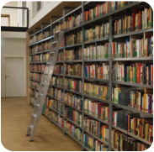
Thank you for your attention!
Livia Fritz, Werner Raza, Manuel Schuler, Eva Schweiger: Export Promotion or Development Policy? A Comparative Analysis of Soft Loan Policies in Austria, Denmark, Germany and the Netherlands,
ÖFSE Edition 19, Vienna: Südwind Verlag, 459 pages
w.raza@oefse.at and l.fritz@oefse.at

Slide 24
The ÖFSE Soft Loan Project
Full report:
Livia Fritz, Werner Raza, Manuel Schuler, Eva Schweiger: Export Promotion or Development Policy? A Comparative Analysis of Soft Loan Policies in Austria, Denmark, Germany and the Netherlands, ÖFSE Edition 19, Vienna: Südwind Verlag, 459 pages
Policy Note:
Fritz, Livia/Raza, Werner: The Future of Soft Loans as an Instrument of Development Finance: an Assessment, ÖFSE Policy Note 11, May 2014
All publications available at: www.oefse.at

