Slide 1
Aid for Private-Sector Development
Tony Addison

Slide 2
Overview
Why private-sector development? (goals: growth, revenue, employment)
Employment is the focus of this presentation
Why? Inclusive growth. High-Level Panel on Post-2015. Gender gap. Stability
ReCom – Research & Communication in Foreign Aid
www.recom.wider.unu.edu
See Aid, Growth & Employment (Position paper)
Donors have not evaluated their employment impact (AfDB exception)

Slide 3
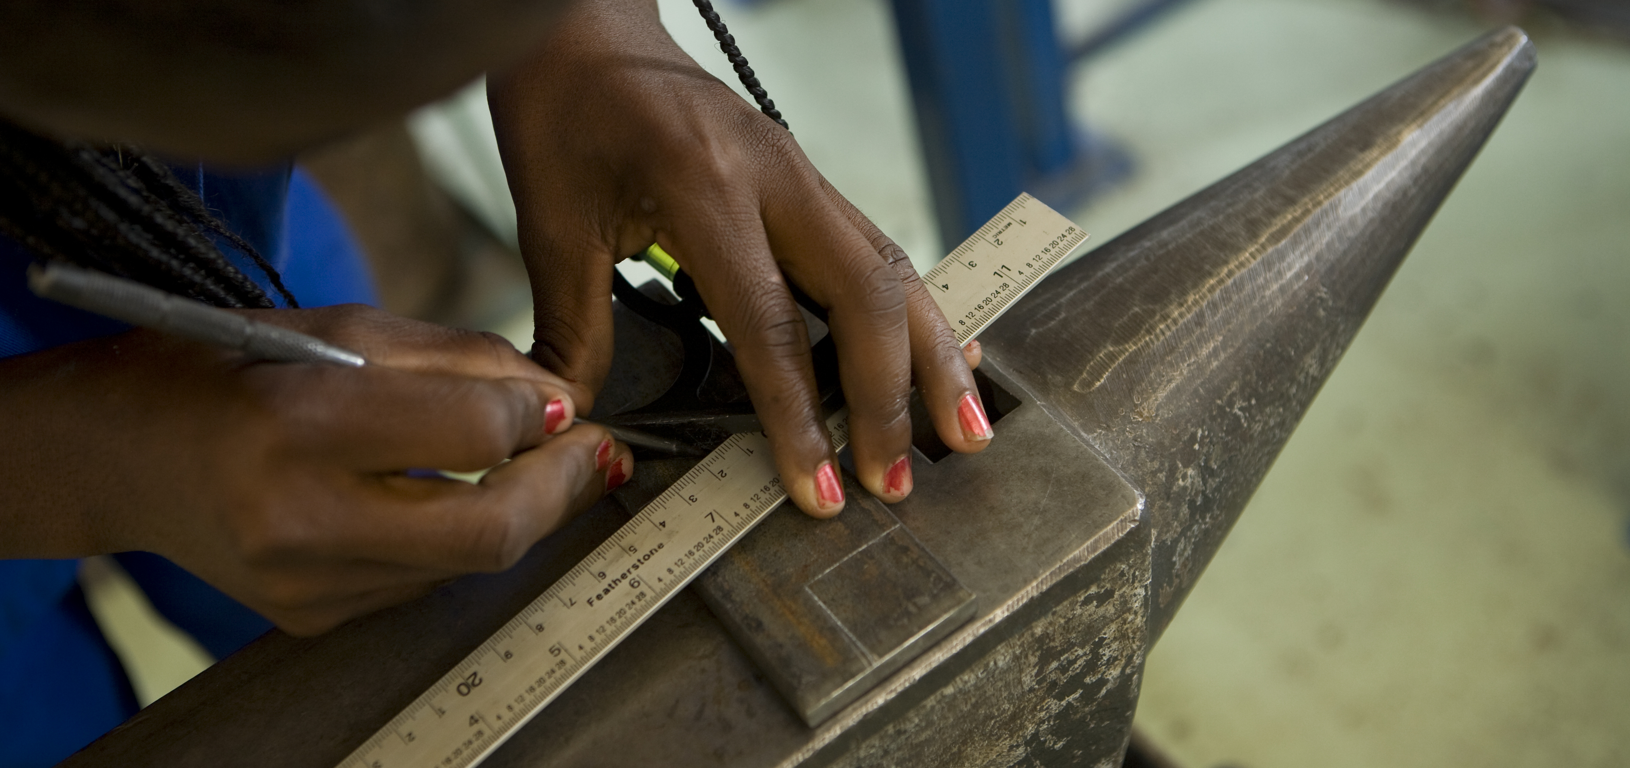
Structural Transformation

Slide 4
Africa: despite high growth, limited structural transformation
Africa: manufacturing share remains around 10% GDP (=40 yrs ago)
Employment: going in opposite direction to Asia – fall in share agriculture, rise informal share
Fastest growing economies have some of the lowest rates of employment creation
Working poor (ILO: vulnerable employment) + gender gap
Productivity low
post-2015 development debate.

Slide 5
Employment intensity and growth in selected African countries
Source: AfDB (2012 )

Slide 6
Demographic dividend v demographic nightmare
SSA population will more than double from 900 mn to 2.1 bn by 2050
Tanzania: from 50 mn today to 129 mn by 2050
10 mn people enter the SSA workforce every year
Most will end up on family farm or in informal work
Donor view led by World Bank used to see informality as result of over-regulation of labour market
But binding constraint on job creation is outside the labour market – in finance, infrastructure etc
Lack of structural transformation – inc. enterprise dev – is root cause of dismal employment & earnings picture

Slide 7
Firms’ perceptions of the investment climate, % of firms
Source: Based on Fox and Oviedo (2013)
Note: *Differences are statistically significant at the 5 per cent level

Slide 8
Infrastructure: a binding constraint on enterprises & communities
Direct employment effect:
Construction industry: private sector development
But procurement works against local contractors
AfDB financed contracts: % of African firms now above 50%
Indirect employment effect:
Infrastructure stimulates private-sector investment & hiring
Exporting firms create more & better jobs at higher wages (Africa: export volumes 16% lower than predicted values)
Problems: Infrastucture (eg Dar port) & cumbersome border procedures (Trade Mark East Africa)

Slide 9
Remittances help build this:

Slide 10
But we also need to build this:

Slide 11
Setting new objectives for aid
Aid for trade : are rich countries delivering on promises
Manufacturing Clusters – SEZs – DAC donors: learn from Chinese experience
Strengthening firm capabilities
Investment promotion agencies
Aid to SMEs popular, yet net job creation?
Doing Business – problematic - yet influential (see J.Page)

Slide 12
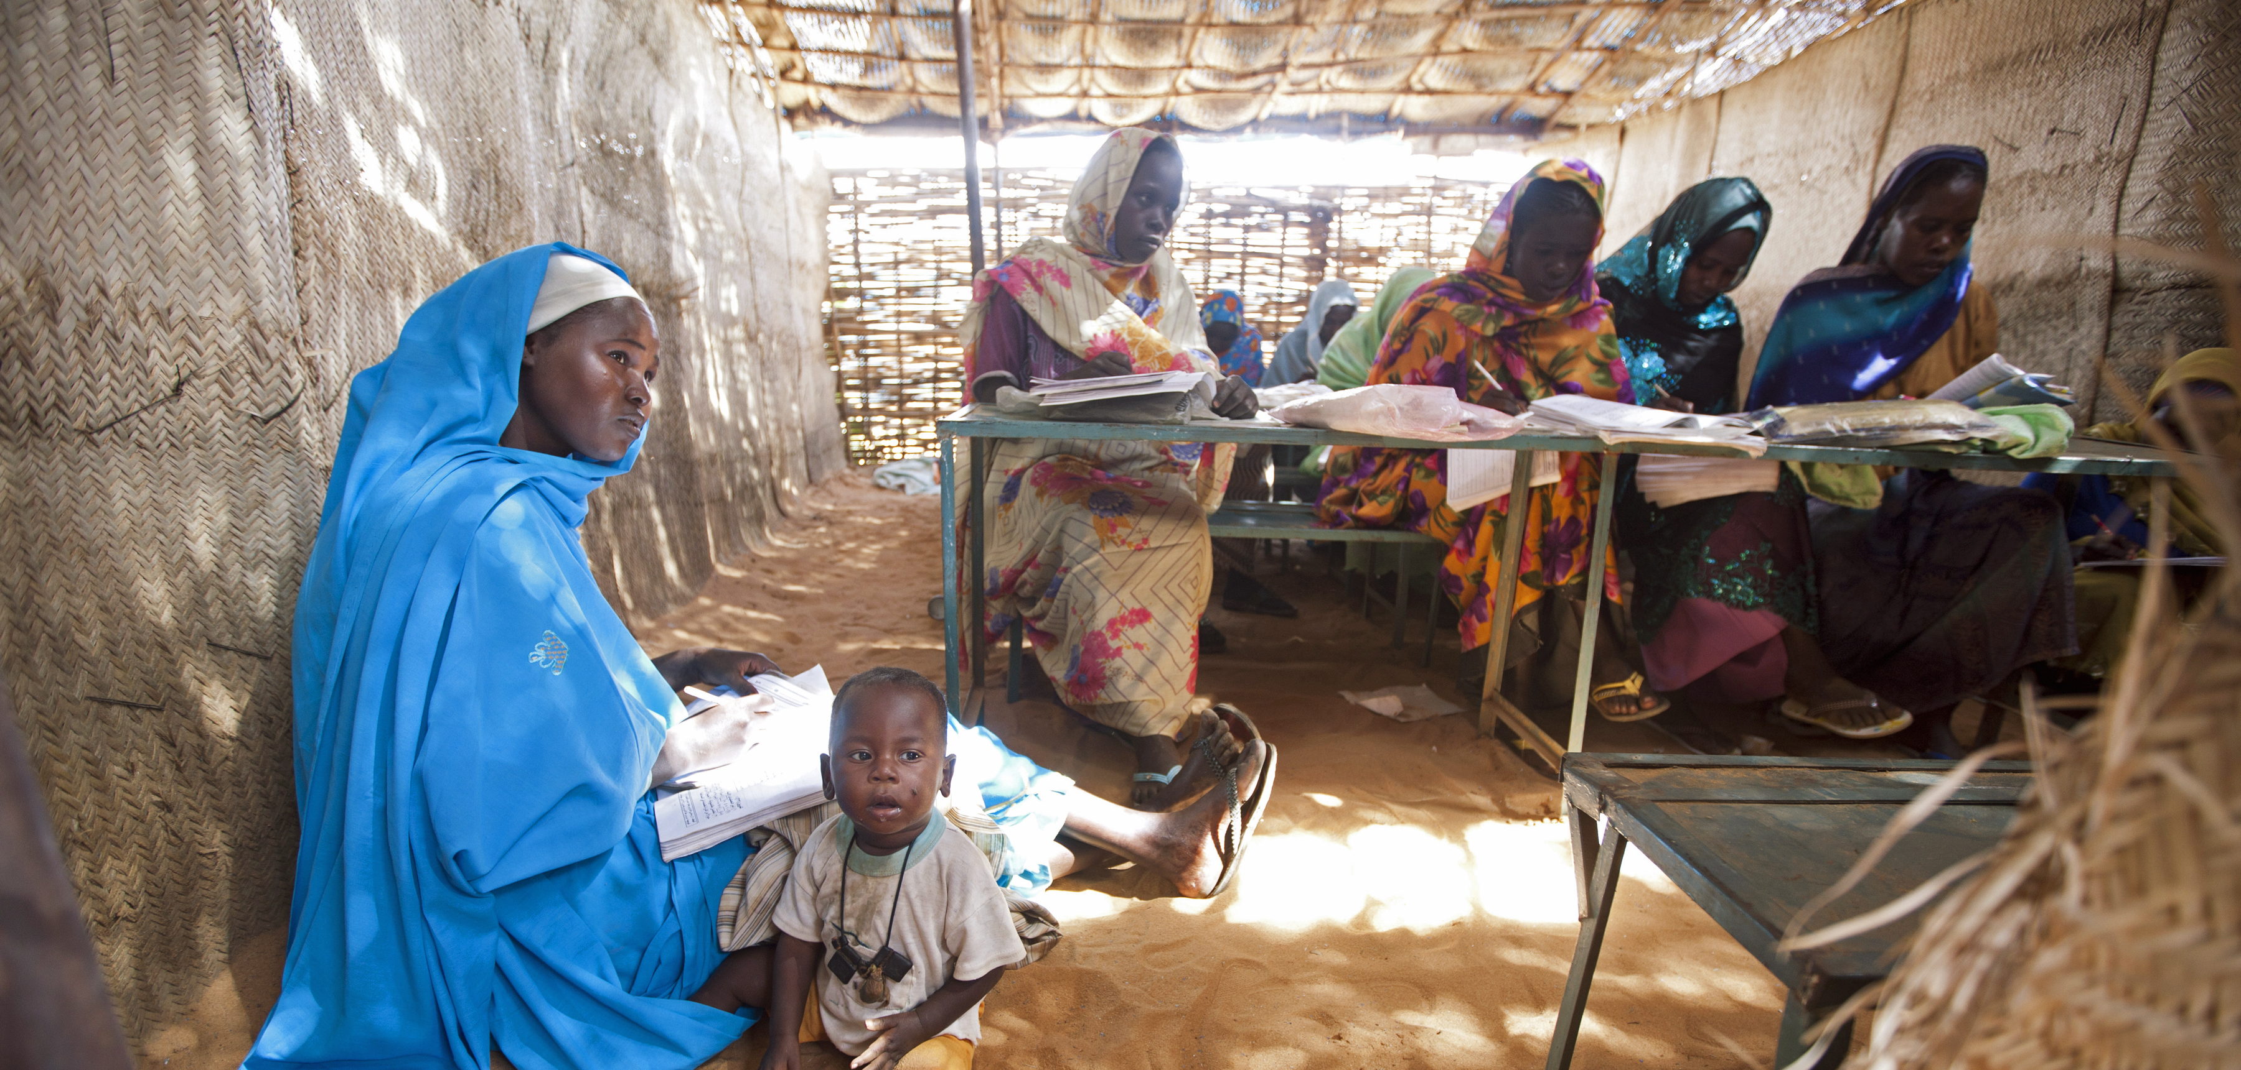
Gender & Private Sector Development

Slide 13
Gender Equality
No inclusive growth if it does not fully incorporate ability of citizens, regardless of gender
DAC has monitored commitments to gender equality since 1991 – about 15% of all screened aid pursues the objective
ReCom concludes that 15% is too low
Highest in education: 30% of all screened aid.
Aid for gender equality languishes in productive sectors: in agriculture aid for gender equality fallen to 15%
Small livelihood projects; little at scale

Slide 14
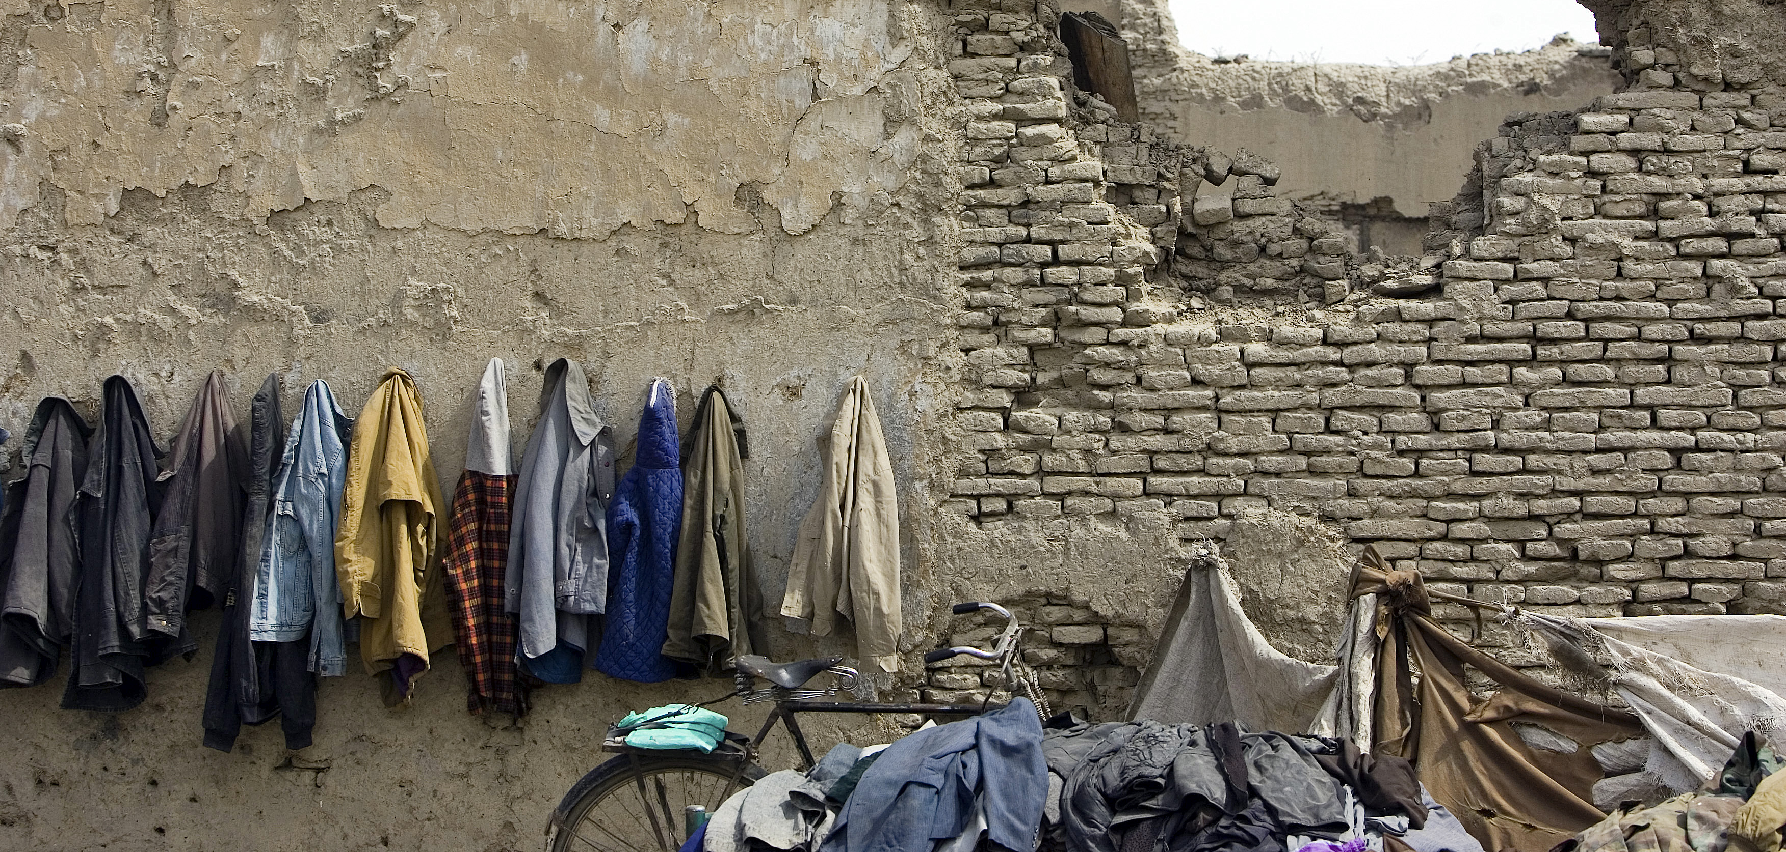
Post 2015

Slide 15
UN High-Level Panel report on the post-2015 development agenda
Calls for:
“..A quantum leap forward in economic opportunities and a profound economic transformation to end extreme poverty and improve livelihoods…”
How can aid help?
Aid to social sectors builds human capital BUT being educated & healthy is not enough (Ethiopia: youth more likely to be unemployed than their elders)
Notes:
Donor efforts in the social sectors have been highly successful – especially in the areas of health and education.
However, for the movement of labour from the agricultural sector to the non-farm economy donors need to be more closely involved in the agricultural and industrial policies.

Slide 16
What will happen to aid allocation post-2015?
Notes:
Measured as % of total aid flows, social sectors have increased from just above 5% of total aid flows in the late 1960s, to around 40% in 2011.
In real terms, aid to social sectors has increased from an average of about 2 billion USD in the 1960s to about 50 billion in the 2000s (in 2011 it reached 64 billion USD)
What does explain that trend?
First, a shift in donor priorities, moving from a strong focus on building infrastructure in the 1970s and 1980s (physical capital) towards investing in human capital (education, health and water and sanitation). This has been explained by a better understanding of the role human capital in the process of social and economic development

Slide 17
MDGs & Post-2015
Aid helps economic growth (overall). BUT:
Unlikely to achieve the HLP ‘quantum leap’ without:
Structural transformation – industrial policy & don’t just focus on SMEs (“East Asia’s donors do it better?”)
Creation of ‘good jobs’ – donors pay too little attention to employment – fragmented livelihood projects
Gender equity at scale – rhetoric, but too-small-scale
Aid to agriculture – slumped & still too low (esp. crop research). IFAD & AfDB ‘going to scale’
Infrastructure – use aid to leverage private capital (e.g. AfDB Africa50 fund). BUT Climate change challenge

Slide 18
Conclusions: Reaching for scale
Need to create millions of jobs not just hundreds
Some 100,000 ongoing aid projects – average small size ($1.7 mn) – median size has been falling
Aid bedevilled by high transactions costs
Inherently political process: ‘private sector’, ‘state’, ‘communities’ – straddling, not isolated from each other
Humility: rich world has a jobs crisis, is advice to the poorer world credible?

Slide 19
http://recom.wider.unu.edu/

