Slide 1
Water-related conflict and cooperation
Causes and implications for food security and sustainable peace in areas of protracted crises
presented by
Helle Munk Ravnborg (hmr@diis.dk), DIIS
based on the Competing for Water research programme¹ (DIIS-FFU)
& the Political Economy of Water Governance Reform research project² (Rimisp-IDRC)
1: www.diis.dk/en/emne/water-governance 2: http://rimisp.org/proyecto/programa-cohesion-territorial-para-el-desarrollo/

Slide 2
(water) scarcity
 competition  tension
 conflict

Slide 3
variability & unpredictability in climatically determined water availability
allocation between users & sectors
rights
?
 conflict & cooperation
changes in (water) availability
 competition  tension
 conflict
population increase
investments & technology
institutions
?
new uses & users

Slide 4
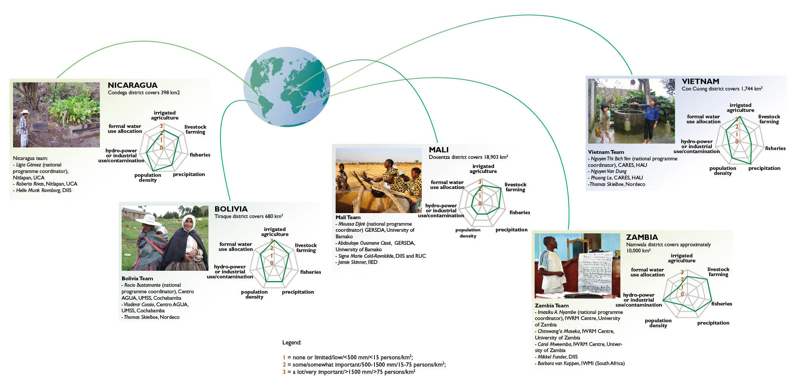
research locations
for the Competing for Water research programme mapping conflict & cooperation in local water governance

Slide 5
Description | Intensity |  | Description
Engage in organized collective violence/ warfare | -7 | 7 | Merge formerly individual access rights
Engage in unplanned collective violence, riots | -6 | 6 | Joint decision-making authority and/or rules development for water use and allocation
Undertake collective large-scale violation of other party’s access rights | -5 | 5 | Establish joint organisational forum
Stage public protests/demonstrations (peaceful) | -4 | 4 | Commit to written or verbal agreements and plans that are sanctioned by a third party
Denounce to authorities and/or third party (formal or customary) | -3 | 3 | Commit to written or verbal agreements and plans that are not sanctioned by a third party
Engage in sporadic/small scale violation or sabotage of other’s access rights | -2 | 2 | Engage in sporadic/occasional joint activities
Engage in informal verbal dispute/expression of discontent | -1 | 1 | Express casual verbal recognition of each other’s access rights
Mapping of water-related conflict & cooperation
Inventories of public* reported and unreported** water-related events & situations taking place between 1997 and 2007
Water event intensity scale
* public ~ involving >4 or involving two different sectors
** reported or unreported to external institutions

Slide 6
What is water-related conflict and cooperation about?
Need for water – water scarcity
Access – competing claims
Rights & institutions

Slide 7
Water scarcity
scarcity make people act
  80% of all water-related events took their beginning during the dry season
but not necessarily conflictively
  conflictive events are no more likely during the dry season than during the rainy season
no straight-forward correlation between climatically determined water availability and
  the number of conflictive events per household – link
  the intensity of conflictive events
– link

Slide 8
…. extent of water-related conflict & cooperation
Number of water-related events per rural household by annual average precipitation
Conflictive water-related events as percentage of total number of water-related events by annual average precipitation
higher number of water-related events does not correlate with climatically determined water availability
greater likelihood of conflictive events
does not correlate with climatically determined water availability
– back

Slide 9
….intensity of water-related conflict & cooperation
Intensity of conflictive events (n=3,132 events)
Intensity of cooperative events (n=2,953 events)
most conflictive
intermediate conflictive
least conflictive
most cooperative
intermediate cooperative
least cooperative

Slide 10
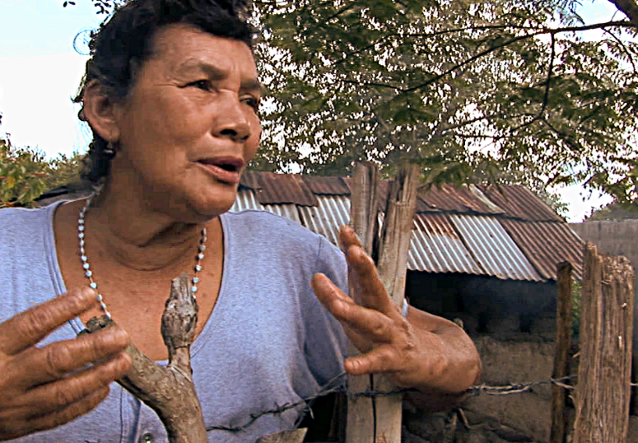
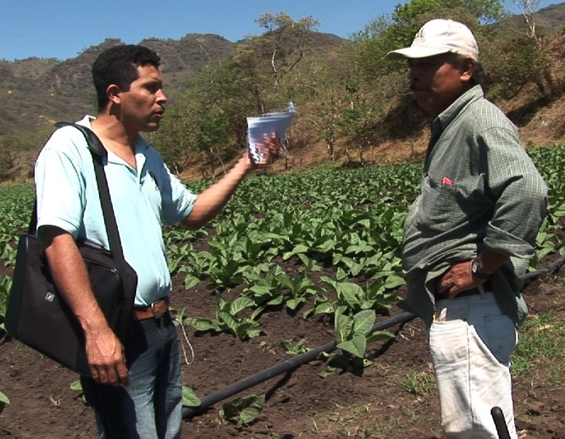
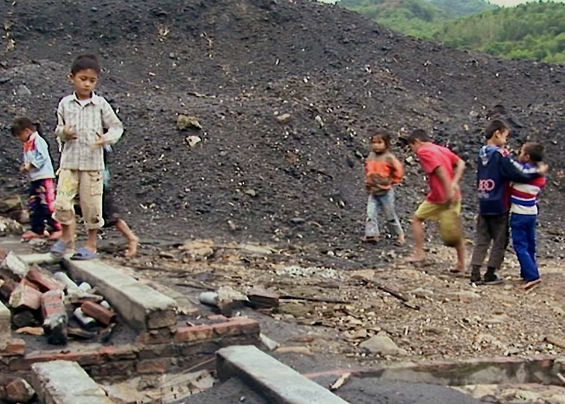
Loss of access due to
”.... because when you cannot settle it here....you have to call upon the authorities”
climatically induced unpredictability
  very dry & very wet years are associated with higher number of water-related events
competing claims & new users, i.e.
  new crops & new technology (irrigation – livestock – domestic water supply)
  mining
  (urban demands)
are associated with mainly conflictive water-related situations

Slide 11
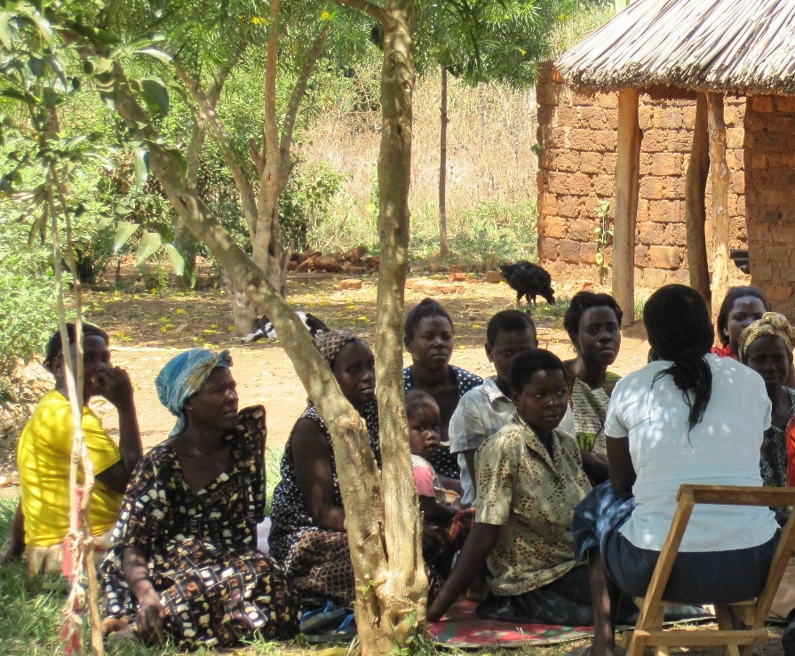
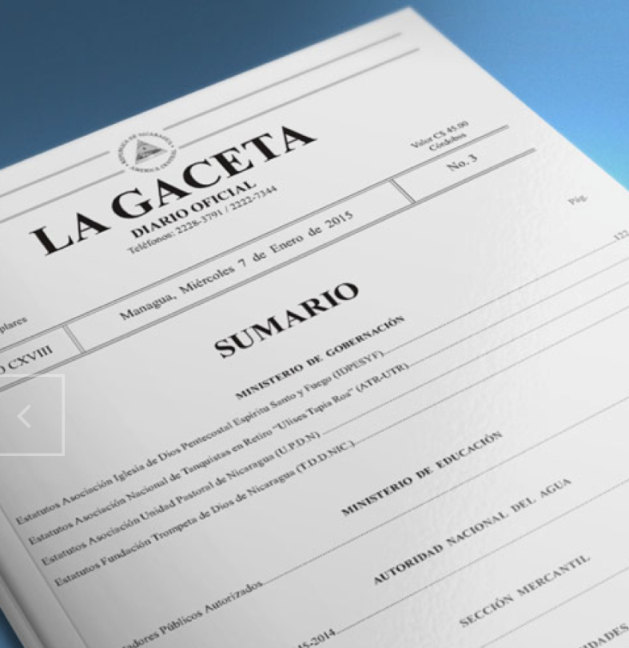
Rights & institutions
… in the context of inequality and limited institutional capacity
Rights & institutions backing rights as ‘tool’ in and as cause of water-related conflict
  coexistence of different and mutually overlapping sets of water-related rights – link
  different groups have different access to these sets of rights and the institutions backing them – link
Competition for water → competition about which sets of rights – and institutions – should prevail over others – link

Slide 12
Forskellige sæt af rettigheder som støtte for krav om vand
How water claims are justified
– coexistence of overlapping and competing sets of rights
constitutional
economic
customary
Back!

Slide 13
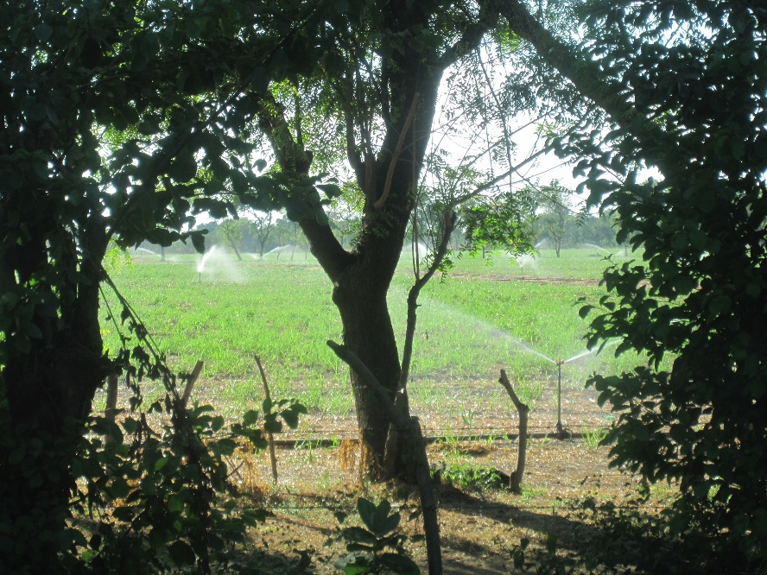
Implementation of (irrigation) water governance reform
importance of irrigation for food, energy and livelihood security is growing due to
  climate change, i.e. unpredictability and variability of rainfall patterns → supplemental irrigation → increase production
  globalisation & changing food demands combined with social & environmental concerns (with water grabbing and water footprints) → demands for formally sanctioned water use rights
– the case of Nicaragua…

Slide 14
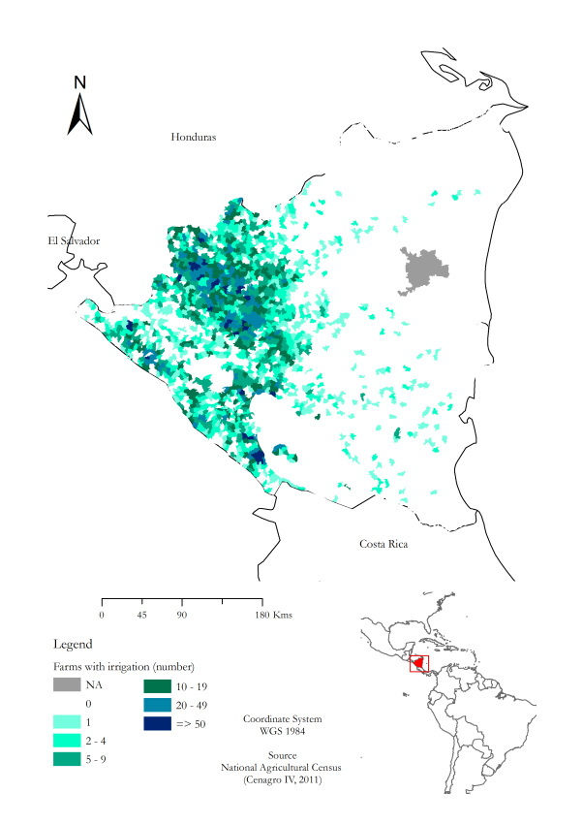
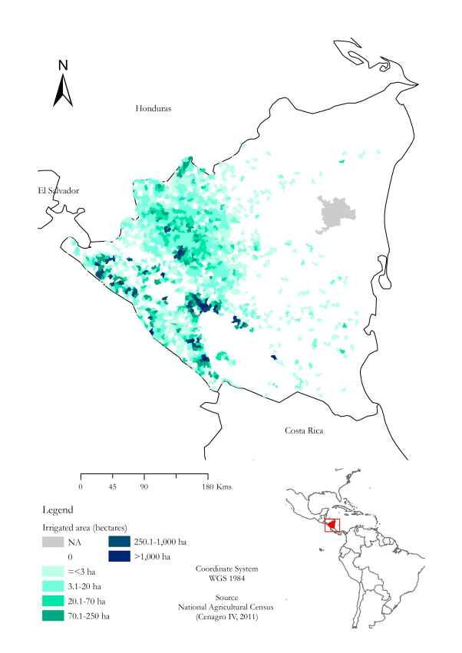
The territorial dimension of irrigation
– more than topography
11,600+ farms with irrigation
75% with irrigated area <3 ha
64% located in sloping areas
78,400+ hecta-res under irrigation
81% at farms with irrigated area >20 ha
85% located in relatively flat areas

Slide 15
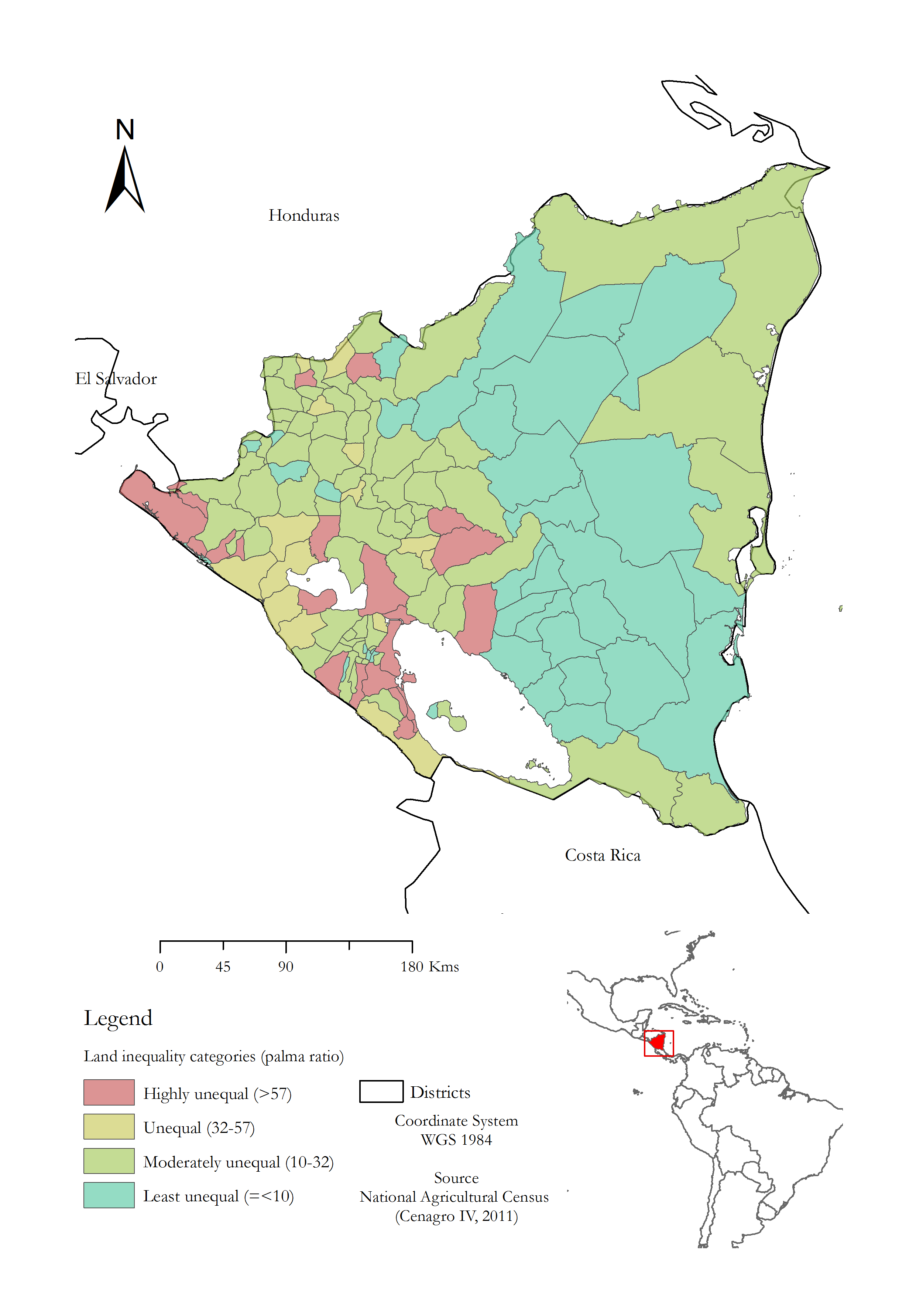
The territorial dimension of irrigation
– land-based inequality

Slide 16
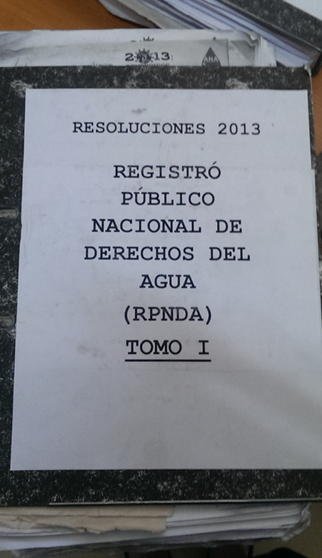
A short note on methodology
systematic review of the Nicaraguan Gazette (available online) in order to
  identify administrative resolutions published by the National Water Authority
  characterize & introduce these into a database
archival research at the National Water Authority

Slide 17
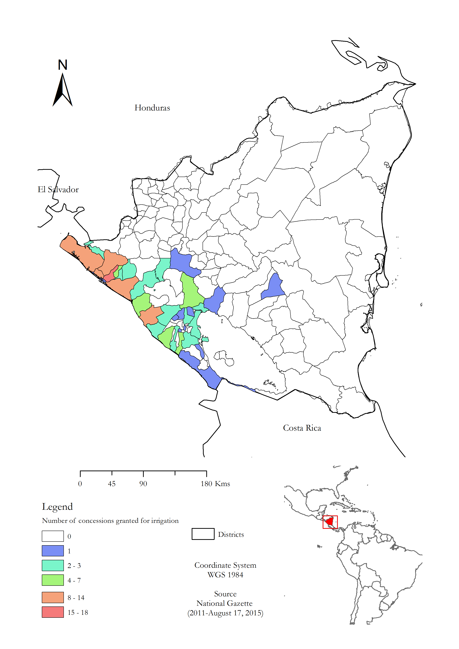

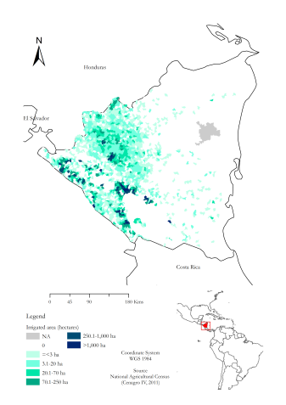
The political economy of water governance reform implementation
Progress by mid-2015:
399 administrative resolutions of which
  116 are concessions of water use rights for irrigation
no cooperation agreements made with districts →
  no authorizations for small-scale irrigation

Slide 18
The political economy of water governance reform implementation – reinforcing & adding a new dimension to existing inequalities
33% of water used for irrigation
1% of farms with irrigation, but
10% of farms >70 ha
Back!

Slide 19
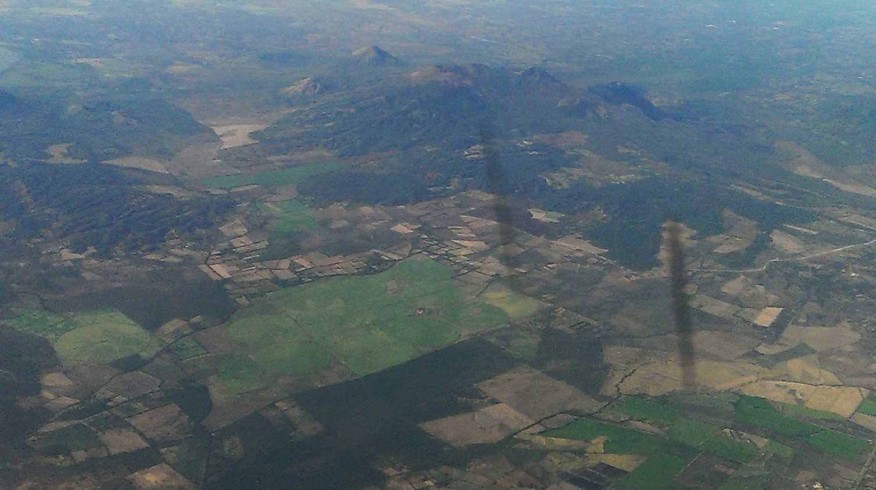
Some implications for enhancing contribution to
SDG2  SDG6  SDG10  SDG13  SDG16
monitor changes in the extent & nature of water-related conflict and cooperation
evaluate the correlation with
  climate change induced variability
  new uses & users
  changes in rights & institutions
avoid the partial implementation & sanctioning of water use rights
adopt a user focused rather than a water focused approach to the formalisation of water rights

