Slide 1
FAO’s Contribution to Sustaining Peace: A renewed corporate priority
Notes:
Given the ambition of the Agenda 2030 and the striking global challenges it seeks to address, over the past eighteen months there has been a renewed commitment at FAO to deepen its contributions to sustainable peace in its mandated areas of expertise, competence and comparative advantage.

Slide 2
Food and agriculture in the 2030 agenda
Notes:
The 2030 Agenda offers a vision for food and agriculture as enablers of sustainable development.
Targets relating to food and agriculture go far beyond SDG 1 (No Poverty) and SDG2 (Zero Hunger) to practically all 17 goals.

Slide 3
Global agendas
“We must use all of the tools at our disposal…to help prevent natural resources from fuelling and financing armed conflict as well as destabilizing the fragile foundations of peace.”
UN Secretary-General, Ban Ki-Moon, 6th November 2014
2030 Agenda - peace as a vital threshold condition for development, and a development outcome in itself
Increased calls for UN system-wide engagements in conflict prevention, peacebuilding and sustaining peace
‘Agenda for Humanity’ / World Humanitarian Summit 2016
Improve interlinkages between humanitarian, development, peacebuilding (financing, programming etc.)
Strengthening resilience to threats and crises
Notes:
The MDGs neither explicitly nor adequately addressed the worrying trend in conflicts worldwide. The 2030 Agenda for Sustainable Development calls for more collaborative approaches to conflict prevention, mitigation, resolution and recovery. A key overarching message is to “leave no-one behind”.
The 2030 Agenda recognizes peace as a vital threshold condition for development as well as a development outcome in its own right.
The universality and breadth of the 2030 Agenda have important implications for FAO’s work in conflict-affected settings that go beyond the linkages to SDG 16 on peaceful and inclusive societies. SDGs 1 and 2 focus on the eradication of extreme poverty and hunger, achieving food security, and making agriculture sustainable. The 2030 Agenda sees achievement of these goals as critical elements in achieving the further goal of ensuring peaceful and inclusive societies.
2015 saw various system level reviews - the Review of the United Nations Peacebuilding Architecture (June 2015), the Review of UN Peace Operations (also June 2015), the Review of the Women, Peace and Security Agenda (December 2015) – which all recommended more innovative, integrated and varied approaches are required to secure sustainable peace.
In April 2016 the General Assembly and the Security Council adopted substantively identical resolutions on peacebuilding (A/RES/70/262 and S/RES/2282 (2016), respectively), concluding the 2015 review of the UN Peacebuilding Architecture. These resolutions are the most comprehensive and far-reaching resolutions on this issue. This ground-breaking achievement outlines a new ambitious agenda and approach for sustaining peace.
These resolutions offer an opportunity to increase the focus of the UN system to preventing conflicts, so that not only the symptoms, but also the root causes of conflicts are addressed. Hence, the concept aims at tackling issues that may otherwise fuel new cycles of conflict. The new resolutions stress that sustaining peace is a shared task that should flow through all three pillars of the UN system’s engagements at all stages of the conflict, and in all its dimensions.
The WHS focused on addressing vulnerabilities and risk. Actors from across the humanitarian, development and peacebuilding communities sought to transcend divides to achieve collective outcomes supporting the implementation of the 2030 Agenda in fragile and conflict affected contexts. This was stated in the Stockholm Declaration of the International Dialogue on Peacebuilding and Statebuilding, which was endorsed by 40 member states in April 2016.
New UNSG has made enhancements to the UN’s performance in the peace and security pillar a real focus. The Secretary-General has stated that more effort needs to be devoted to preventing crises by addressing the root causes and supporting strengthened institutions, resilient societies, and full respect for human rights, and when prevention fails, more must be done to resolve conflicts via mediation, arbitration and creative diplomacy.
I will now broadly outline how threats to peace, and fragility, impact on food security to illustrate why contributing to sustraining peace is of concern to FAO given its mandate.

Slide 4
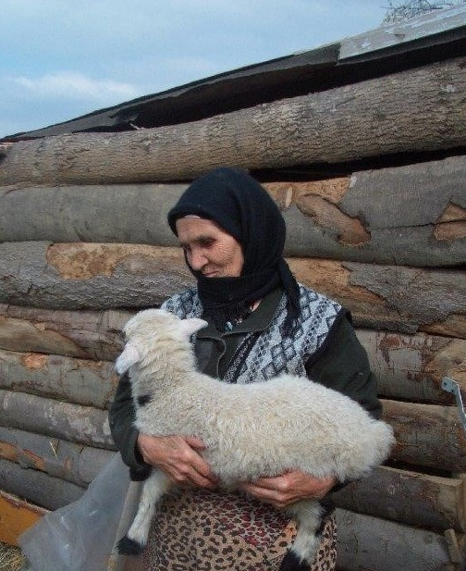
Freedom from fear, freedom from want
Created towards the end of WWII, FAO seen as having a vital role in achieving and sustaining peace:
“…the Food and Agriculture Organization is born out of the need for peace as well as the need for freedom from want. The two are interdependent. Progress towards freedom from want is essential to lasting peace.”
“…make the maximum contribution possible to healthier and more abundant life, and to a peace built on day-by day, practical cooperation among the peoples of the world.”
Notes:
The relationship between freedom from want and the need for peace is not a new area of work for FAO. From the first Session of the Conference of FAO, and by its founding fathers, this interdependece was recognised. Indeed, FAO’s work over the subsequent seventy years has contributed to achieving these goals by focusing on the eradication of poverty and the achievement of food security and nutrition for all.
This is by way of highlighting that FAO’s work on contributing to sustainable peace is not something new or outside of it’s mandate. It’s something we have been doing, one way or another, for a long time.
Since its founding, the UN Food and Agriculture Organization (FAO) has been dedicated to addressing the pressing challenges facing food and agriculture systems – and the global populations that depend on them – on land and sea. A persistent focus has been the myriad conflicts, both destructive and constructive, that characterize the multiple natural resource-based pathways for livelihood security and national development. Given FAO’s proximity to all aspects of food and agriculture systems, it has long been appreciated that agriculture, natural resources, food security and nutrition can be a source of both peace and conflict, of both crisis and recovery and of both tragedy and (as the image on the this slide depicts) healing:
“In an interview (through a translator), we asked about the impact of the FAO livestock project. She said, ‘The most important benefit is neither the wool from the sheep nor the shelter for the sheep. It is the lamb, this lamb.’ That lamb brought her renewed joy after so much loss. She said FAO had provided a meaning to her life. And if that is not the best impact we can hope for, what is?” FAO staff member on an evaluation mission, Ingushetia, 2011
Over time, using a range of technical, policy and legal avenues, FAO has worked in solidarity with Member States to facilitate the management of conflict and to mitigate the consequences of destructive conflicts. This has been an essential condition for resilient agriculture development and sustainable natural resource management, as well as for supporting vulnerable populations to cope with dignity in times of crises.
However, whilst the historical archives are rich with examples of FAO’s work on conflict drivers, in conflict contexts and on delivering development assistance through conflicts, the challenge now is for the Organization is to move from often idiosyncratic initiatives to a more systemic approach to promoting sustainable peace.

Slide 5
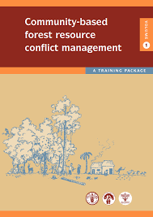
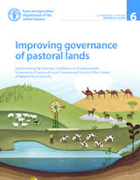
Conflict, peace & food security
Some conflict drivers relate specifically to FAO’s mandate and competencies
Investments in agriculture, food security and nutrition can contribute to stability, conflict mitigation, prevention and recovery
Addressing root causes of conflict based on equity in economic development, rights-based approaches, improved governance, dialogue
Notes:
The drivers of conflicts range from ethnic tensions, religious differences, discrimination, poor governance, limited state capacity, population pressure and rapid urbanization to other factors such as poverty and youth unemployment.
However, some conflict drivers relate to FAO’s mandate and competencies – as these earlier publications addressed.
These include conflicts that have been driven by, inter alia, competition for land, water and other natural resources, the multiple dimensions of food insecurity, the neglect by governments of marginalized areas, or environmental mismanagement.

Slide 6
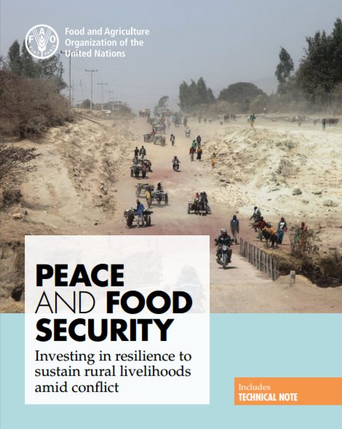
FAO’s focus on sustaining peace
FAO DG to UNSC (subsequent joint report with WFP)
FAO-Nobel Peace Laureates Alliance
World Humanitarian Summit commitments
Corporate framework on contributing to sustainable peace
Assessment of UN AFP capacities for sustainable peace
Focus for SOFI 2017
Notes:
During 2016, various events and related reflections within FAO took place.
The FAO Director General addressed the UNSC for the first time, at an Arria-formula event on food security and peace. The FAO-Nobel Peace Laureates Alliance was convened with the explicit aim of tackling the twin problems of hunger and violence.
In this spirit, FAO leadership has directed the Organization to focus more effectively on contributing to sustainable peace in order to raise levels of nutrition, to enhance efficiency in food and agriculture production and distribution, to improve the lives of rural populations, to fight poverty, and to free the world from the scourge of hunger.
The aim of these efforts is to ensure that FAO, in its areas of competence and comparative advantage, realizes a more deliberate and transformative impact through:
at a minimum, supporting the food security, food production and sustainable use of natural resources of conflict-affected populations;
where development is possible, notwithstanding conflict contexts, advancing progress on the SDGs through conflict-sensitive approaches;
and, where food systems, natural resources or food insecurity are drivers of conflict, working directly to reduce conflict risks.

Slide 7
A more coherent governance approach
Working on conflicts (conflict drivers): identifying ways to minimize, avoid and/or positively transform and resolve conflict(s) where food, agriculture or natural resources are, or could be, conflict drivers
Working in conflicts (conflict impacts): developing and implementing interventions to offset the impacts of conflicts on food security, nutrition, agriculture and natural resources, by saving lives and supporting livelihoods directly impacted by conflict(s)
Working through conflicts (conflict-sensitive development): continuing to advance development in countries and regions affected, or potentially affected, by conflict(s), but doing so in a conflict-sensitive manner
Notes:
For many years, FAO has worked, within its mandated competencies, on various aspects of sustainable peace. FAO is adapting a helpful framework developed by Oxfam/Novib to categorize FAO’s range of engagements in support of sustainable peace:
Working on conflicts (conflict drivers): identifying ways to minimize, avoid, positively transform and resolve conflict(s) where food, agriculture or natural resources are (or hold the potential to serve as) conflict drivers, including reducing the potential for a relapse into conflict in the context of strategic post-conflict reconstruction and recovery;
Working in conflicts (conflict impacts): developing and implementing interventions to offset the impacts of conflicts on food security, nutrition, agriculture and natural resources, by saving lives and supporting livelihoods directly impacted by conflict(s);
Working through conflicts (conflict-sensitive development): continuing to advance development in countries and regions affected, or potentially affected, by conflict(s) in a conflict-sensitive manner.
Some conflict drivers – but certainly not all – specifically relate to FAO’s mandate and competencies. These include those that have been driven by, inter alia, competition for land, water and other natural resources, the multiple dimensions of food insecurity, the neglect by governments of marginalized areas (such as arid and semi-arid landscapes essential for livestock-dependent populations, poor rural areas, or subsistence fishing grounds), or environmental mismanagement.
FAO has used its technical competencies to directly promote sustainable peace, including reducing and/or addressing conflicts before they escalate. In addition, where there are opportunities within FAO’s mandated areas, the Organization strives to reduce the risk of relapse into conflict in post-crisis contexts by engaging with the parties to the conflict, including men, women, youth and the elderly; by assisting stakeholders in addressing the root causes of conflict and conflict drivers; by interventions that reduce fragility and underpin stability; and by offering technical insights into conflict dynamics in order to identify possible entry points and solutions.
FAO works in conflicts to save lives, enable people to remain in their communities, support internally displaced and refugee populations, address malnutrition, guard against environmental destruction, prevent sexual and gender-based violence, restore food production and protect agriculture systems. With a particular focus on dignity, comparative cost-effectiveness and the coordination of multi-actor response strategies, FAO deploys its competencies in conflict contexts to address the multiple threats to food security and nutrition and to support the range of livelihood strategies that at risk populations rely on to manage risk and vulnerability. Given a focus on strategies with both a rapid and lasting impact on food security, FAO’s work in conflict-affected situations also supports effective transitions between humanitarian action and development processes.
Around 10 percent of FAO’s field programme delivery in the most world’s fifteen most fragile contexts in 2016 was development assistance. Such efforts to work through conflicts require contextual understanding and conflict analysis to ensure that interventions do not heighten conflict risks and hence avoid doing harm. Such an approach to conflict-sensitive development distinguishes “working through conflicts” from a ‘blind-eye’ approach to development.

Slide 8
What next?
Change in mindset - working towards a more deliberate and transformative impact on peace
Developing new relationships and complementary partnerships
Learning from experiences, internal and external, and from different sectors
Operationalizing corporate framework (capacities, tools, programming, project cycle, assessments, analysis)
Consistent application of a conflict-sensitive approach
Building the evidence base through research, M&E
Notes:
Advocacy - both internally and externally (NB SOFI 2017). Need to change the mindset to a deliberate, preventative approach, and from short-term and output-based interventions to longer-terms sustainable and collective outcomes, linking with strategic focus on resilience building.
Evaluate activities and programmes and learn and share lessons. Recognize that historically we have some useful experiences and approaches. Look at how these can be captured, adapted and scaled up (e.g. PTND, experience with community-based animal health interventions, DDR support to livelihoods) etc.
Develop and build new relationships and partnerships: dialogue with InterPeace and academic institutions (PRIO, DIIS, Uppsala etc.). The UN to do more multi-dimensional conflict and risk analysis., engagement of FAO (e.g. in Burkina Faso for IAWG mission on sustaining peace), joint identification of collective outcomes.
Consistent application of a conflict-sensitive approach across all FAO’s humanitarian, development and investment work:
systematic study of the profile, causes, actors and dynamics of conflict
maximize positive impacts toward peace while minimizing negative impacts, including the potential for creating ‘future hazards’
necessary in all contexts (even where underlying tensions have not resulted in violence)
Interventions, initiatives, activities and programmes are based on a conflict analysis and address the drivers of violent conflict through the formulation of a theory of change.
Research to build the evidence base on the relationship between FSN/agriculture and contributing to sustainable peace – e.g. inclusion of survey questions/modules in M&E of projects, exploring longer term research objectives and related research agendas.

