Slide 1
Climate change adaptation interventions and natural resource conflicts
- the case of Zambia
Mikkel Funder
Carol Mweemba
Imasiku Nyambe

Slide 2
Climate change and conflict
The climate change and conflict debate
Emerging consensus: Climate change as contributing factor
Interact with long term conflicts – eg Kenya right now
But how do adaptation interventions themselves affect conflicts?
Some attention to mitigation politics (REDD+, biofuels etc)
But what about adaptation?
Highly political: It’s about resources, people and production
Implemented in areas with contested authority and limited state reach

Slide 3
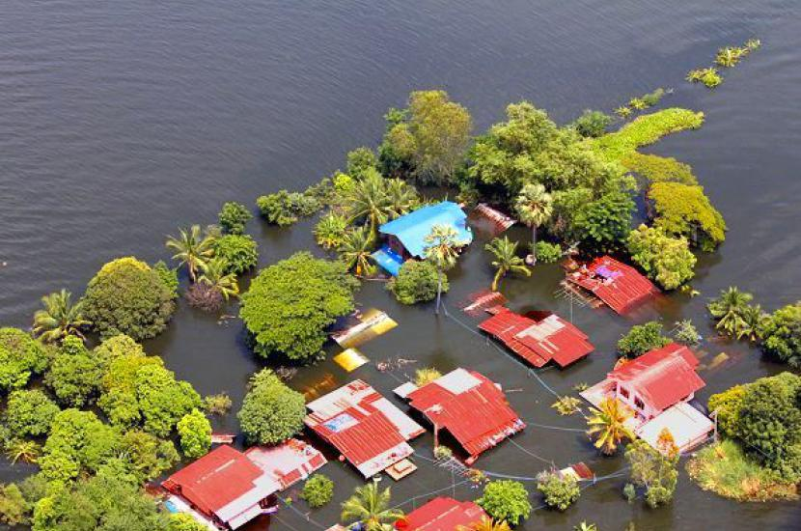
Climate Change and Rural Institutions
Climate Change and Rural Institutions research programme
Meso-level institutional responses to climate change
Collaboration with partners in Nepal, Uganda, Vietnam, Zambia

Slide 4
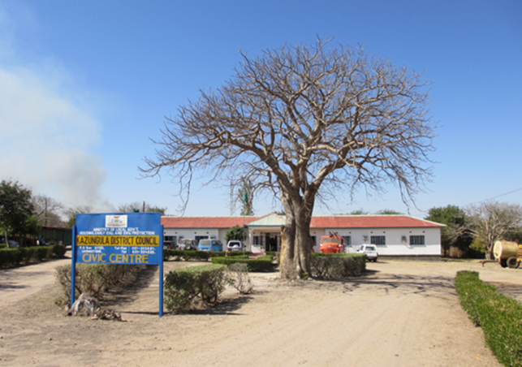
Methodology
Main steps
Study of the historical context of climate change frameworks
Local institutional mapping
Tracing local evolution of climate change agenda
Process studies of selected adaptation interventions
PhD study of community adaptation and responses
Main techniques
Qualitative/ethnographic interviews
Household survey (n=200)
Focus group interviews
Participant observation
Workshops

Slide 5
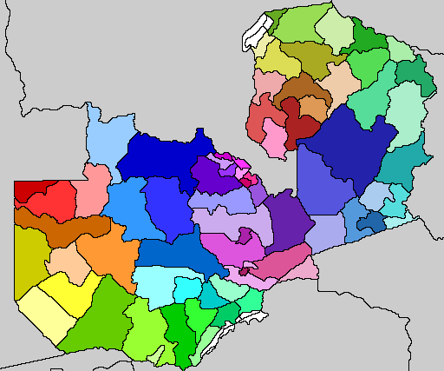
Study sites in Zambia
Rural drylands
Smallholder maize & cattle economies
High poverty rates
Low food security
”Frontier hinterland”
Sesheke
Kazungula

Slide 6
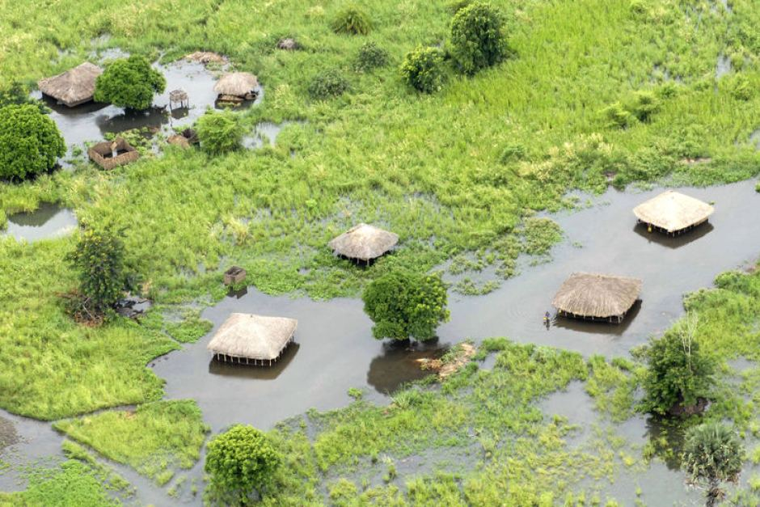
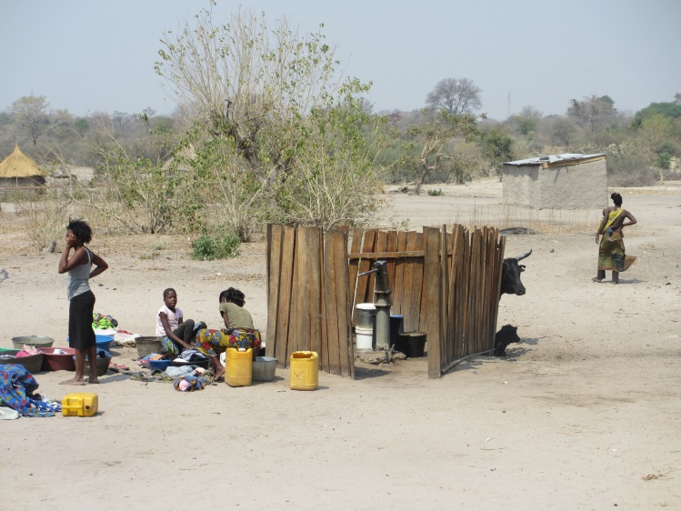
Climate change in the study areas
Extreme events and gradual change
Floods and droughts
Changing rainfall and temperatures
Climate change adaptation interventions
Introduced by NGOs, donors, media
Picked up actively by state organisations, Local Governments, chiefs, communities

Slide 7
Local resource governance and conflicts
Institutional context
Fragmented authority and resource control
Multiplicity of local institutions
Limited reach of central state
Access conflicts
* Access to fertile land, water, pasture, forests, protected areas
* Expanding smallholder agriculture/in-migration
* Cattle economy recovering
* Land investments developing
Control conflicts
State vs Chiefs (land, water)
State vs Local Governments
(revenue, state lands)
Political conflicts
Ethnic politics, secession discourse

Slide 8
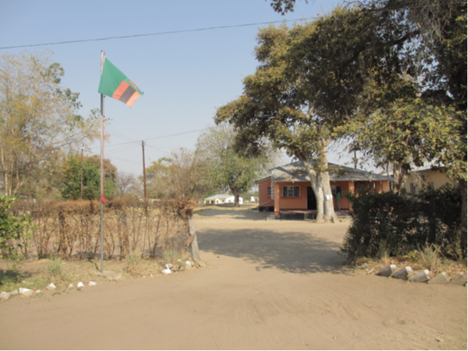
Local resource governance and conflicts
Adaptation is becoming an arena
for fighting out broader conflicts
– and contributing to them
Key adaptation interventions:
Resettlement (“planned relocation”)
Livestock management
Conservation agriculture

Slide 9
Resettlement
Floods > displacement
Conflict
coercive resettlement
Conflict
access to land and water
Intervention: Resettlement
Voluntary scheme
Land title deeds
Extension for adaptation
Early maturing maize
Drought tolerant crops (cassava etc)
Conflict
between chiefs and state over land control
Link to broader conflict:
State vs Chiefs
Who governs?

Slide 10
Livestock management
Drought
Conflict
Cattle not goats!
Conflict
Seasonal movement
Intervention
Shift from cattle to goats
Intensify/sedentarise
-to enhance production
-reduce disease
Link to broader conflicts:
Ethnicity
Lozi secession
“Pastoral way of life”

Slide 11
Conservation agriculture
Unpredictable rainfall
Rising temperature
Conflict
Used to contain agric. expansion
into forests/wildlife corridors
Farmers:
Gvt is holding us back
giving land to conservation, timber companies, big farms
Intervention
Conservation Agriculture
minimal soil disturbance
permanent soil cover
crop rotation
Long-standing policy
Link to broader conflicts:
Conservation
Land investments

Slide 12
So…
Adaptation interventions in the study areas are fueling conflicts:
between households
between households and extension agencies
between customary and statutory institutions
What’s going wrong?

Slide 13
State interests in adaptation
The wish to act:
The politics of food security
Fueling the motorbikes of a starved civil service
But: The Great Temptation
Climate change justifies intervention in production and organisation
Adaptation = a way of governing people and resources
Adaptation = a way of extending state reach and authority
Also Mocambique, Zimbabwe, Vietnam
The disconnect
Universal national policies vs local needs/context
Long standing policies continue in new forms

Slide 14
However…
Adaptation also provides opportunity for communities and local institutions to stake new claims

Slide 15
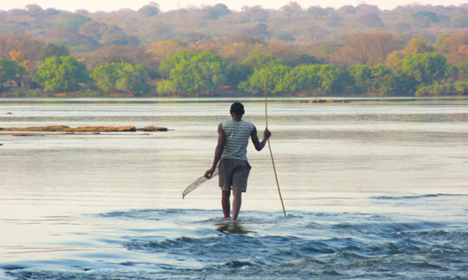
Households
Resettlement
Some HHs pursue “double strategy” of customary and statutory rights
Livestock management
Opportunity for agro-pastoralists to leverage mobility strategies “(indigenous knowledge”)
Conservation agriculture
Using yields to engage/challenge extension services

Slide 16
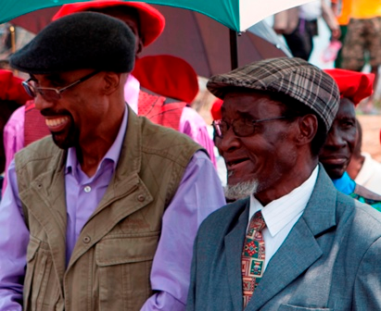
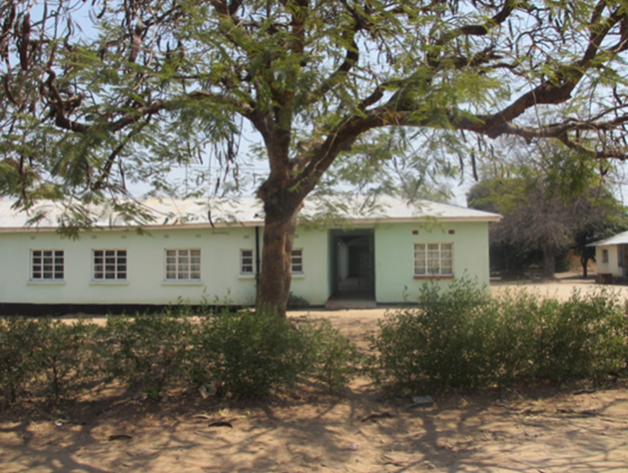
Local Governments:
Climate change as argument for devolution
Degazette state forests for community adaptation
Demand driven approach: water!
Chiefs:
“Indigenous adaptation” discourse
Boosts legitimacy in communities

Slide 17
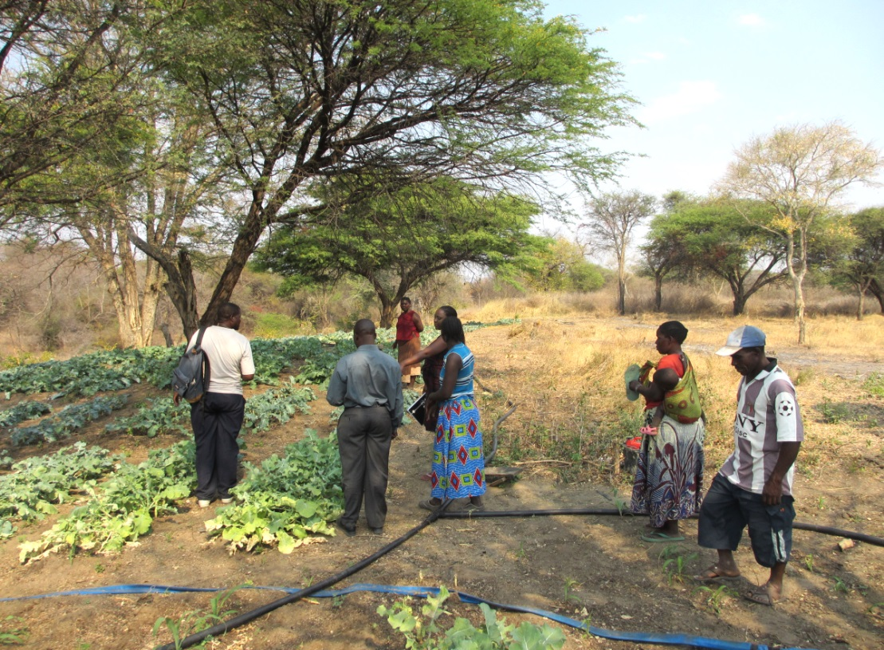
The challenge:
Adaptation interventions may fail
Conflicts may escalate
The poorest will suffer most
The opportunity:
Opportunity to voice grievances
Challenge exclusionary resource access and control
Promote devolved approaches

Slide 18
What can be done?
New FAO suppl. guidelines on NAPs on the right track
Acknowledge conflictive nature of adaptation
Conflict & resolution understated in adaptation policies/guidelines
Bring in conflict/negotiation tools from forestry/GreeNTD/REDD+ work
Address links between adaptation and land/water rights
Land/water conflict and rights screening (add to NAP guidelines?)
M&E: No. of land and water conflicts reported through local institutions
Knowledge needs: autonomous adaptation, land investments, cooperation & conflict?

Slide 19
What can be done?
Bring resettlement and domestic displacement “onto the radar”
UNFCCC: “Planned relocation” - guidelines under development
But resettlement experience missing + need integration with adaptation policies
More focus on domestic climate displacement and conflict (Uganda, Kenya)
Work at the meso-level
Local Governments are key - Kenya County Adaptation Funds – FAO Cap. Dev.
Link adaptation/NAPs/NDCs to decentralization policies (silos)
Demand driven approaches – PPCR Zambia – water!
Support planning flexibility of local line agencies (structural change)

